Slide 1
Nuovi strumenti di sviluppo locale: l’effetto delle infrastrutture digitali sulla creazione di lavoro autonomo. Analisi di un caso applicato nello stato di New York
Lucia Bazzucchi
bzzlcu1@unife.it

Slide 2
Research’s Aims
Research objective of this paper is to analyze the effects of broadband network externalities on local development.
In particular, I will look at the effects of
BB networks → on autonomous work and self-employment
Digital Agendas (BB networks deployment) debates
+
Labor market policies
Why?

Slide 3
Intuitions and literature references
Literature references
- Network externalities definition and measurements:
Capello (1994); World Bank (2009); Crandall et al. 2007; Greenstein and McDevitt 2009; Holt and Jaminson 2009; Wallsten 2010
Internet and entrepreneurship:
Czernick et al. 2011; Shirky 2010
Network effects on labor market:
Kolko (2010). “Does Broadband Boost Local Economic Development?”
Crandall et al. (2007). “The Effects of Broadband Deployment on Output and Employment: A cross sectional Analysis of US Data”.
Katz R., Suter S. (2009). “Estimating the economic impact of the Broadband Stimulus Plan”
Broadband EFFECTS
The labor market
1. Substitution between
Technology and Labor Force
-
2. Low entry barriers in new markets; reduction of efficient firm size;
new market space for services
+
(self-employment; new business opportunities)

Slide 4
Methodological Approach
Deductive Approach
The effects of broadband are positive on self-employment at the local level
New York State case
Find implications for local development policy actions
Why NY?
- New York State’s market is a mature market for Broadband Infrastructure and Services, however differences among counties within the state still exists in terms of bb penetration and uptake (urban vs. rural penetration rate) – ..it offers a representative spectrum of different network effects and intensities.
- To reduce the complexity of the research framework to a smaller level.

Slide 5
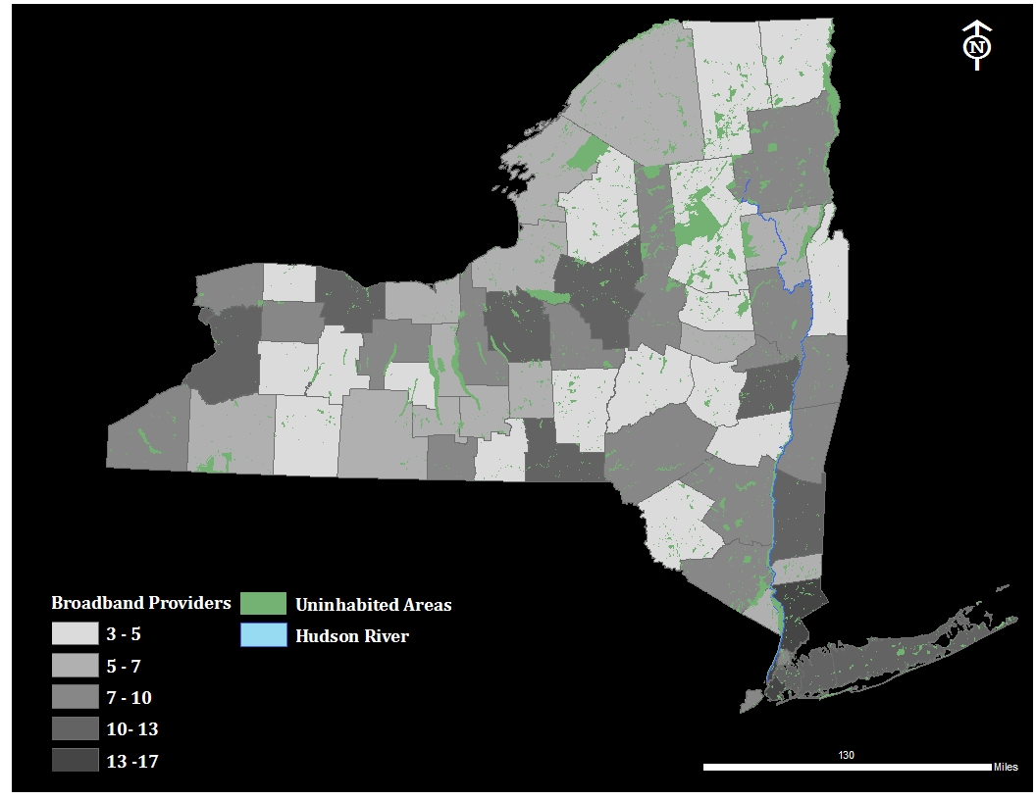
New York State Broadband Penetration – N. of BB Providers (FCC: 2009)

Slide 6
Theoretical Model and Parameterization
self-employment rate = ecological factors + labor market conditions + technology externalities
Krugman (1991)
Core-periphery resources’ distribution
Demand size
Average level of income
Human capital
Shultz (1975)
Labor demand
Opportunity cost of opening an individual activity
Capello (1994)
Network externalities as “those positive effects (not entirely paid for) that new subscriber receives (or generates) from joining a network”
Model complexity
Spatial lag-model
Dynamic model
Time-space simultaneous model

Slide 7
Data and Methodologies
Space Lag Model: Anselin et al. (2008)
Spatial weights (contingency) matrix based on spatial proximity
a spatial weights matrix W is a N x N positive matrix in which row and columns correspond to the cross sectional observations. In this case the matrix is binary with
equal to 1 when i and j are neighbors and equal to 0 when they are not. The matrix is then normalized, such that the elements in each row sum to 1.
Spatial lag operator is constructed by creating a new variable that is equal to a weighted average of neighboring observations with the weights as specified in W. For a variable z
I obtained
The spatial lag operator of the dependent variable is then applied in the regression on the RHS. But since it is is endogenous (by construction) it has to be instrumented (IV or GMM) with the available exogenous instruments. The procedure suggested by Anselin et al. (2008) is to instrument with the spatial weights of all the other exogenous variables.
GMM model estimates: Arellano, Bond (1991)
Dynamic models of short panels (N>>T) cannot be efficiently estimated through OLS estimators because of endogeneity of the lag parameter. Arellano, Bond introduced GMM estimators that are based on the generalized method of moments and where the endogenous variable is instrumented with a set of internal instruments both in differences (GMM-diff) and in levels (GMM-sys), improving the efficiency and reliability of estimates.

Slide 8
Data and Methodologies (II)
Variable | Description | Source | Status
self-employment | N. of records in the “non-employer statistics” register over population | Census Statistics US | Dependent variable
internet | Average number of Internet providers (faster than 200 kbps) | Federal Communication Commission (Form 477) | Independent variable
income | Per capita average income | Bureau of economic analysis – U.S. Department of Commerce | Independent variable
education | Per capita federal spending in education | U.S. Census Bureau – Federal, State and Local Governments – Consolidated Federal Fund Report | Independent variable
population | population size | Bureau of economic analysis – U.S. Department of Commerce | Independent variable
compensation | per capita wage level | Bureau of economic analysis – U.S. Department of Commerce | Independent variable
Units of analysis: NY State’s counties
Time span: 2002 – 2009
Models explored:
POLS (pooled OLS)
FE (fixed effects)
RE (random effects)
IV (instrumental approach)
GMM (generalized method of moments)
Look for stability of parameters
endogeneity

Slide 9
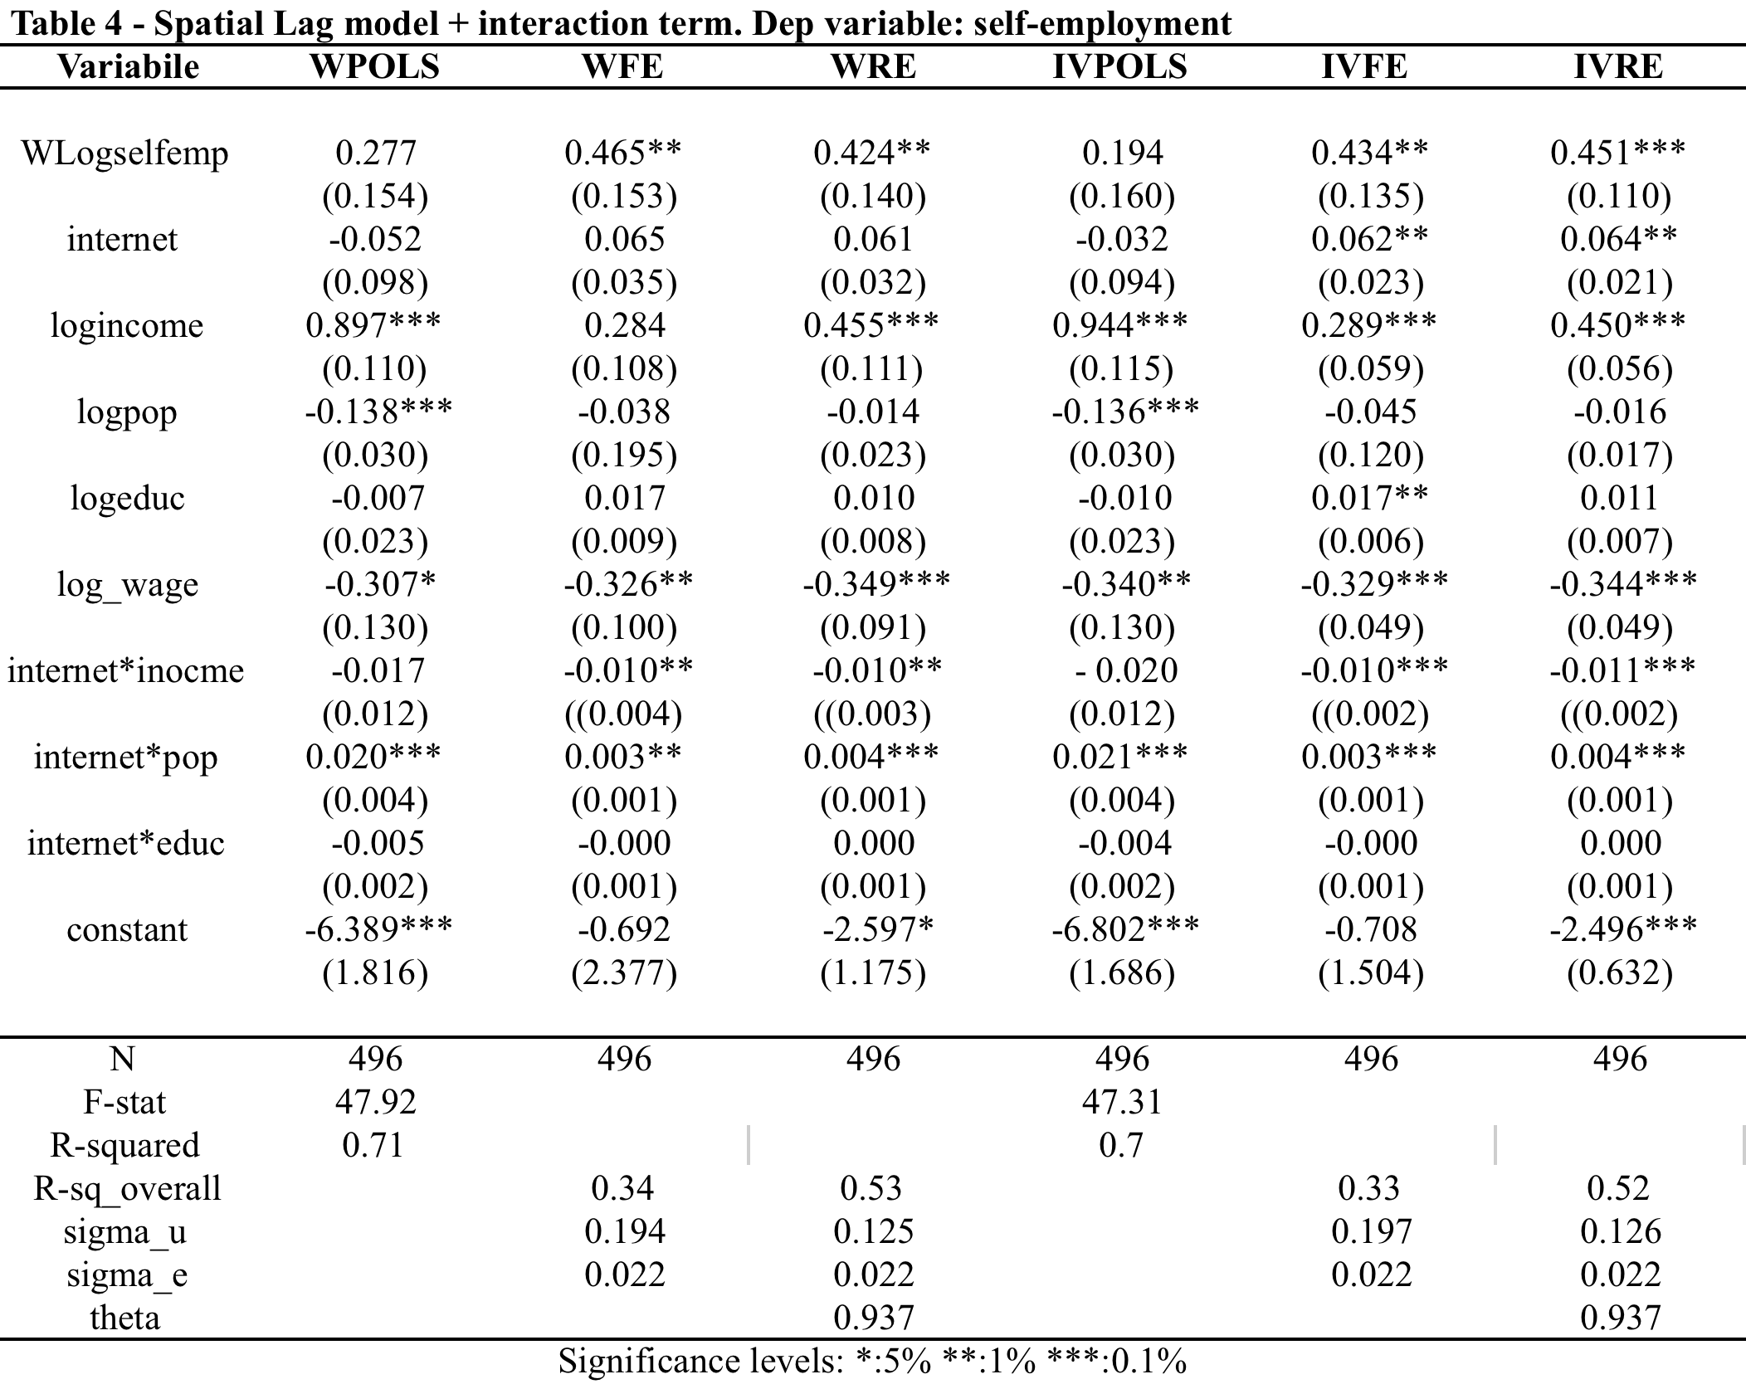
Results

Slide 10
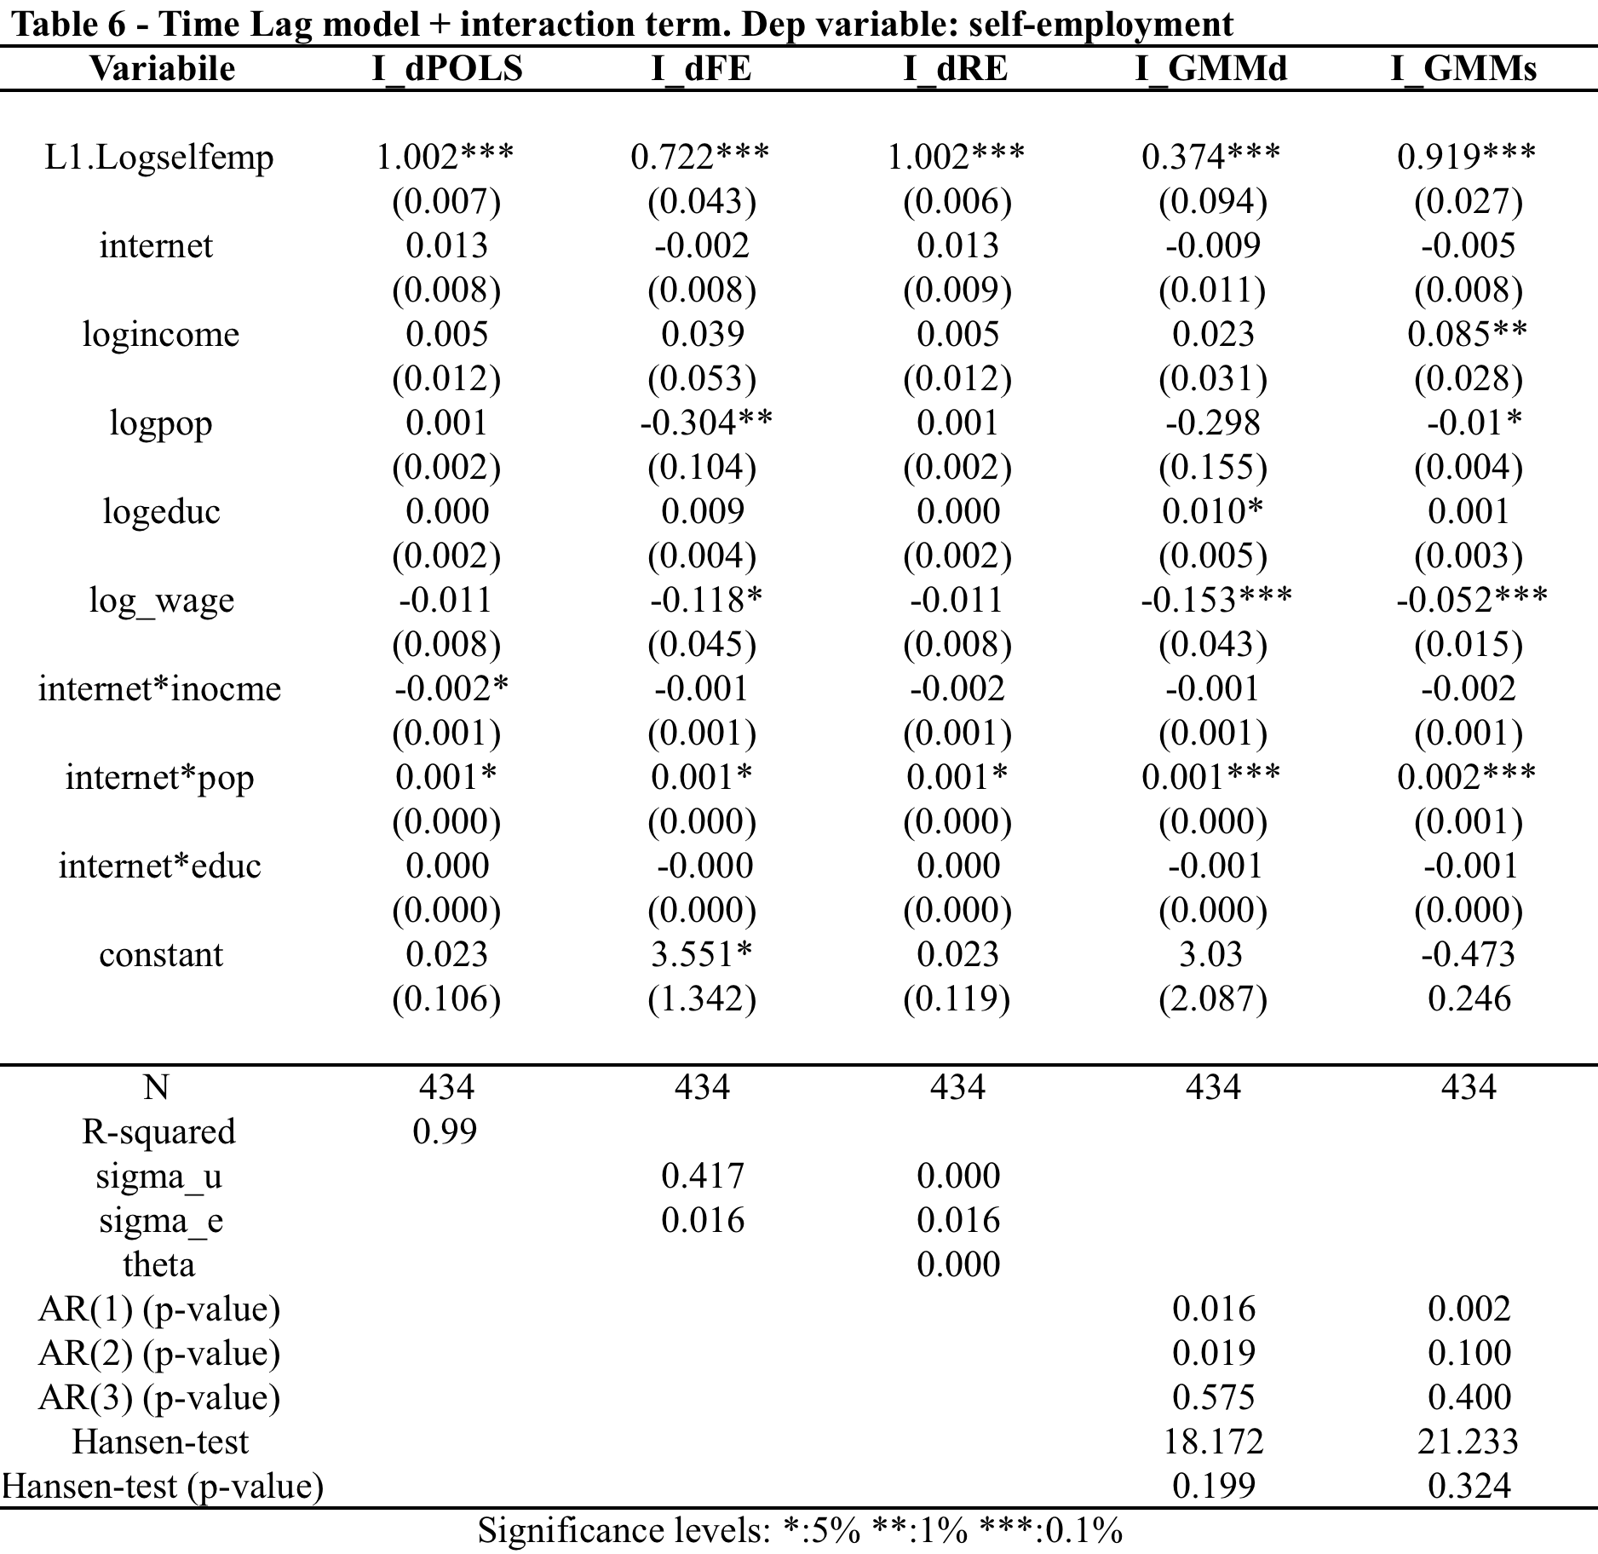
Results (II)

Slide 11
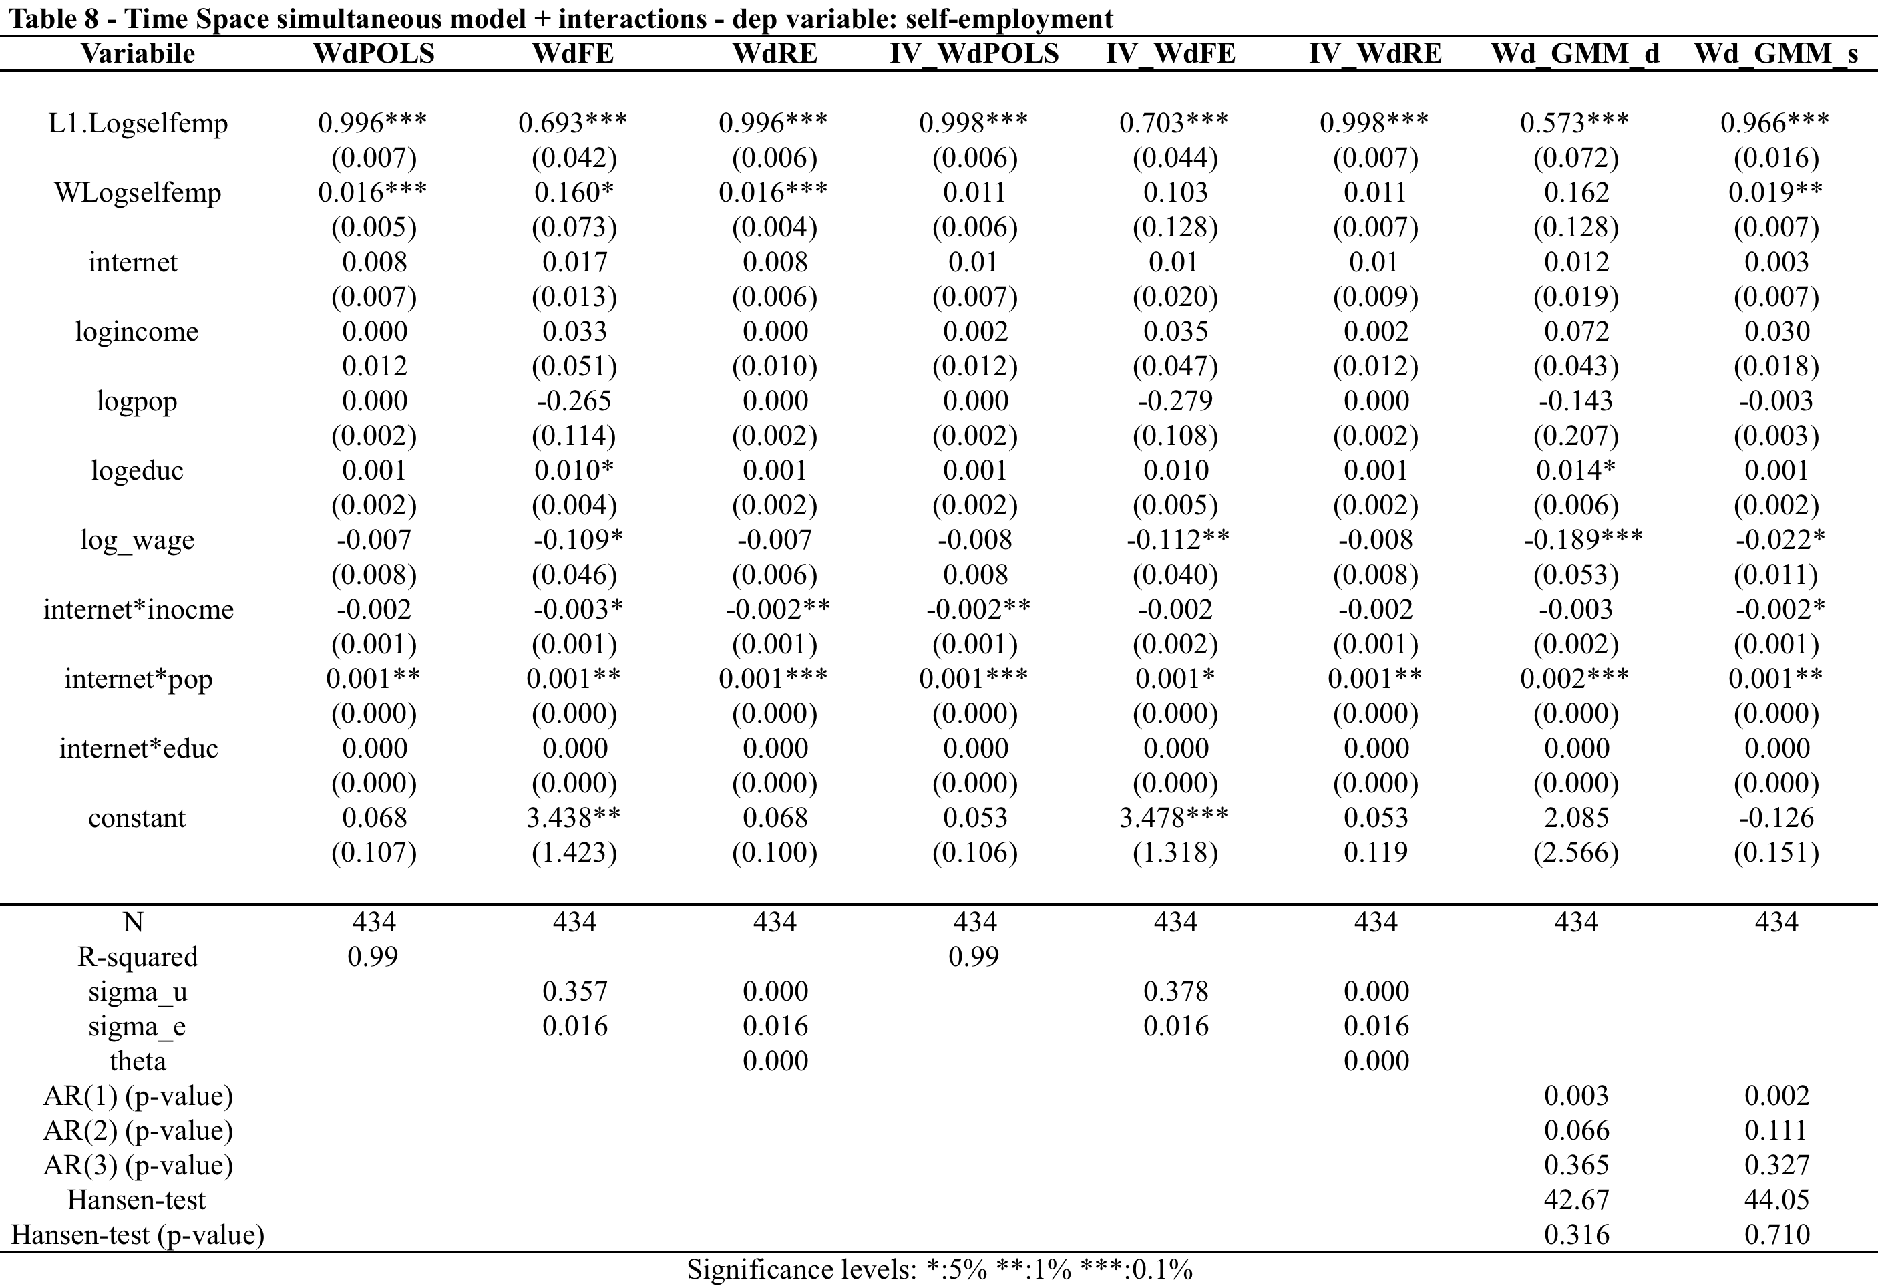
Results (III)

Slide 12
Main findings
Self-employment is a persistent phenomena
At a spatial level, neighbors count, meaning that I recognized the presence of positive effects given by spatial proximity
The model specification doesn’t seem to be too wrong, I obtained consistent results across different parameterization and model estimates.
MOREOVER
Broadband network effects are shown to be positive and significant when interacted with demand side characteristics and human capital investments
In particular, network effects on self-employment become significant and positive for those counties where a minimum critical mass is reached
Also, networks effects on self-employment are negative for those counties where the level of economic outcome is already high (high income levels) → this result may be explained as a saturation effect, or as the sign that the ACTUAL effect of BB is higher for counties that still lag behind in terms of economic development
THEREFORE
We found some evidence that there is a POSITIVE relation between BROADBAND PENETRATION and SELF-EMPLOYMENT

Slide 13
Policy implications to maximize network effects on self-employment
 | Objectives | Modalities | Instruments
Supply Side | Increase network penetration Definition of high standards for technology and contents Create digital ecosystems that explicitly support local development dynamics Increase data security | PPPs -Coordination and decentralization of interventions Cooperative exchange of knowledge and resources (Block, 2011) | Subsidies for local infrastructure development and improvement Incentives to create digital platforms to create, share and make available contents and applications for self-employment initiatives R&D subsidies for projects that study and exploit the relationship b/w BB and local development Insurance program specific for B to B and B to C activities Integration of BB strategies (Digital Agendas) within local structural development policies
Demand Side | Increase access Create a demand that is informed, skilled and conscious of network externalities opportunities Increase trust and confidence in network transaction and information Increase protection and consumers’ security | PPPs -Coordination and decentralization of interventions Cooperative exchange of knowledge and resources (Block, 2011) | - Direct subsidies to the demand side (consumer vouchers, hardware technology availability, etc) Promotion and development of anchor points “Forced awareness”

Slide 14
Limitations
Data
Broadband penetration is only proxied through providers’ competition levels
We miss relevant information about technology speed and real competitiveness of different areas
The unit of analysis may be smaller than counties because broadband penetration levels and technology quality may change from one street to the other
Self-employment is measured just as an aggregate measure at the county level, without specifications of actual entry and exit of people from this status – persistency is obviously high
Identification of network effects
I tried to estimate a microeconomic model with aggregate data – ecological inference problems
A short time series
Missing variables (?)
Simultaneity of effects (endogeneity)
Poolability of data

Slide 15
MANY THANKS !!
Lucia Bazzucchi
bzzlcu1@unife.it

